Slide 1
OCR Cambridge Nationals CREATIVE iMedia
Key dates:
External examination – MONDAY Jan 11th 2020
MOCK EXAMINATION – MONDAY 14TH December
Key information:
External examination R081 –25%
Coursework 1 R082 - 25%
Coursework 2 R085 - 25%
Coursework 3 r087 -25%

Slide 2
F.a.q
Can my child resit their examination? There is 1 resit opportunity– this can take place in June 2020 or during year 11. This will be decided on an individual student basis. There is only 1 reattempt opportunity.
Who marks the coursework? All coursework is marked by the class teacher and then moderated by the examination board. Coursework can be updated and changed based on teacher feedback.

Slide 3
OVERALL GRADES – 4 elements
Exam - 60
Coursework 1 – 60
Coursework 2 – 60
Coursework 3 - 60
TOTAL MARKS 240
216 | L2D*
192 | L2D
168 | L2M
144 | L2P
120 | L1D
96 | L1M
72 | L1P

Slide 4
WHAT CAN YOU DO TO HELP?
Tretherras School has spent a great deal of money on fantastic revision resources. These can be found under 0365 Student Shared/ Creative iMedia/ Blended Curriculum/R081-exam
The link is https://newquaytretherras.sharepoint.com/:f:/s/O365StudentShared/ElzJ6YcNuchOkT44RIhrzaAB0iLtrGkm6OPcGa123-ne_g?e=9fRWXh
Parent suggestion – ensure your child has completed and revised all knowledge maps and has worked through questions and checked answers in the iMediaR081 Booklet Final Revision found at https://newquaytretherras.sharepoint.com/:b:/s/O365StudentShared/EeeiPghscslDo06tLEhvQmEBTlNrsQyKmC5TICkbsQ7Arg?e=5CPJL7

Slide 5
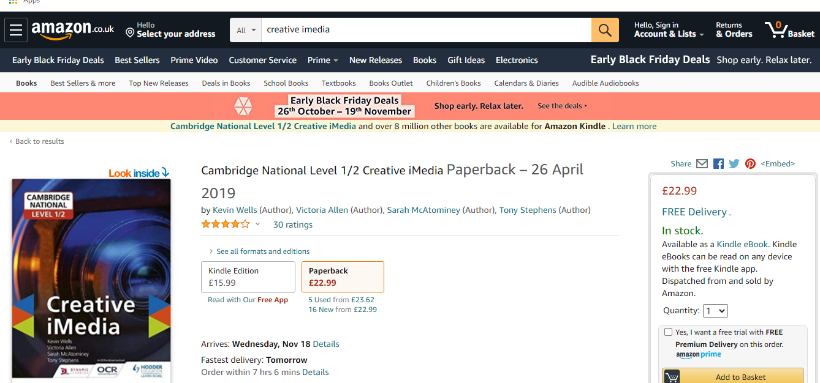
WHAT CAN YOU DO TO HELP?
Many students choose to purchase the course companion listed above from Amazon or other websites – it is a great help over the 2 years.

