Slide 1
How to access…

Slide 2
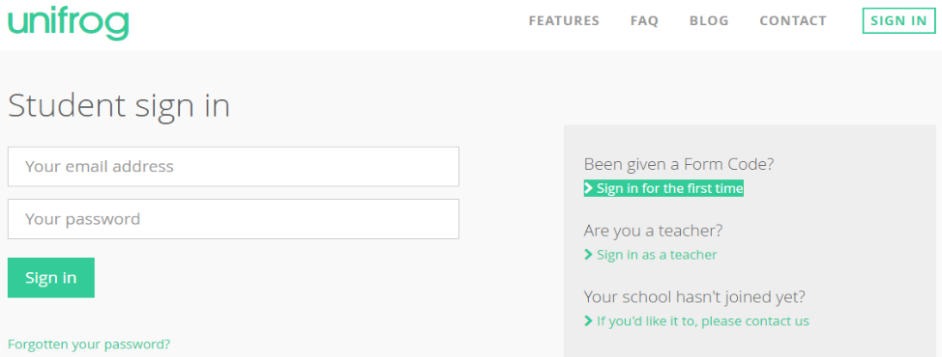
https://www.unifrog.org/
You should have been sent an email with a link to your school email address.
firstnamesurname19@students.tretherras.net
Follow the link and set yourself up with a password.
SAVE THIS PASSWORD ON YOUR PHONE
If you can’t find the email (it could be in your JUNK EMAIL folder) – click on ‘forgotten password’ and this should generate another email.

Slide 3
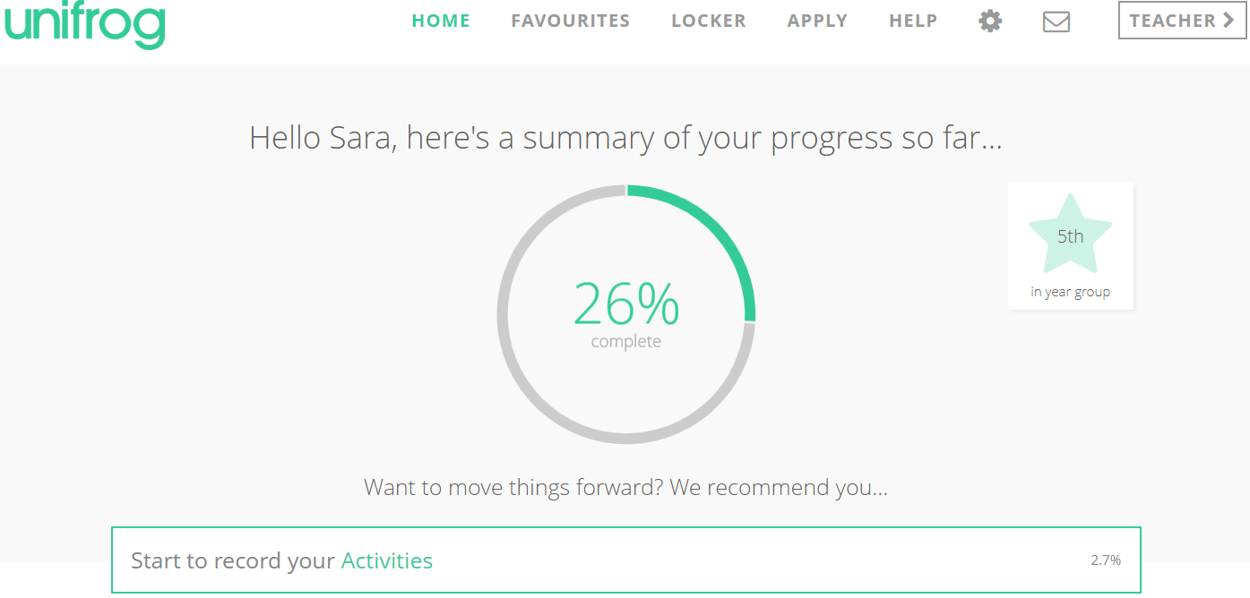
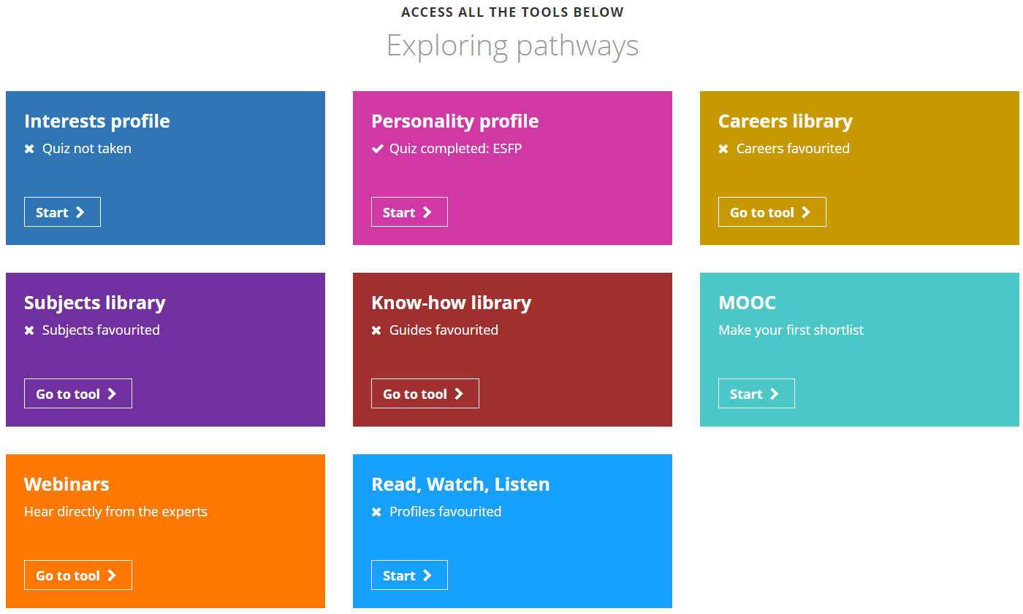

Slide 4
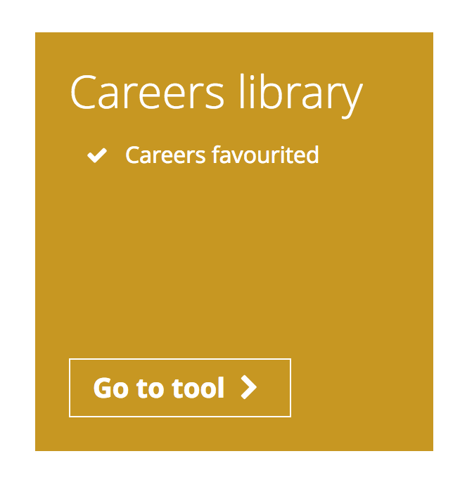
Once you are on, scroll down and spend some time looking at the Careers Library & Subject Library.
The Careers library allows you to explore career options by providing information from a range of sources, including interviews with people working within the industry.

Slide 5
Once you’ve found a role that interests you, watch interviews from people working within that industry, and read more about the skills required for the role.

Slide 6
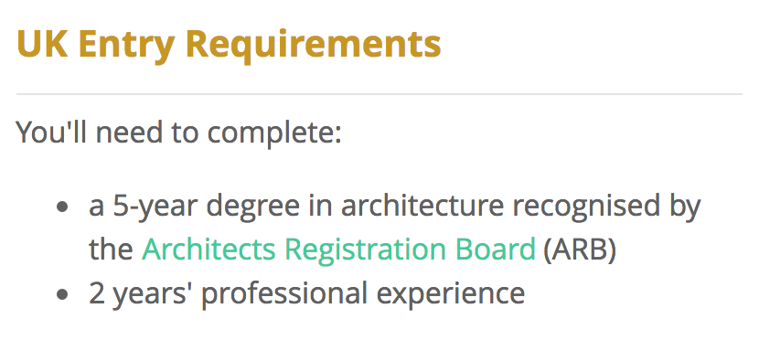
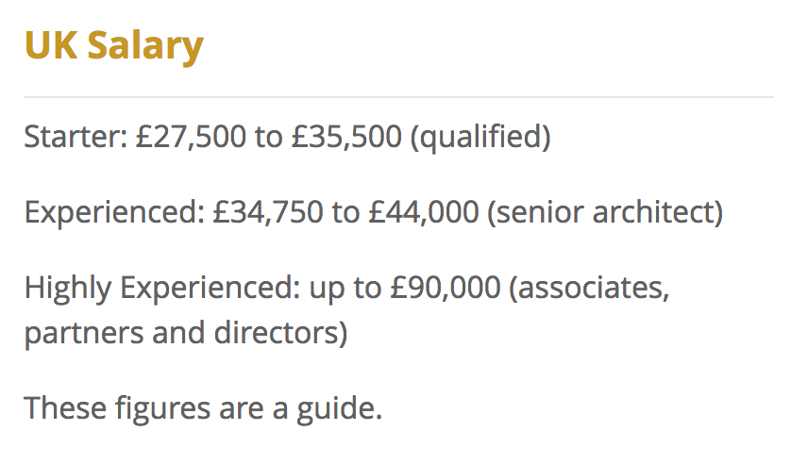
You can also find out more about entry requirements, various routes into the role and expected salaries.

Slide 7
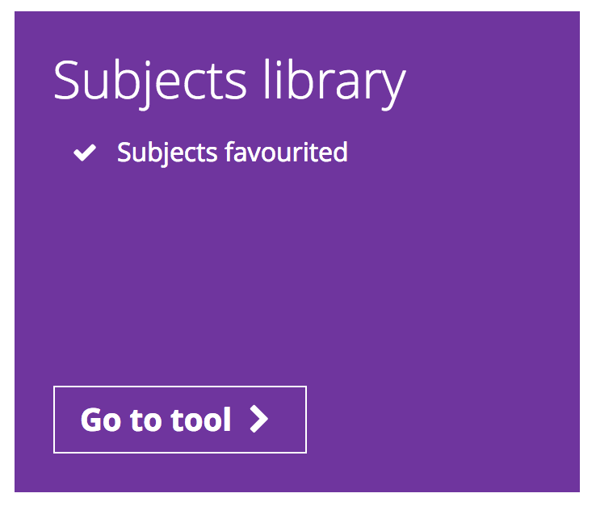
The Subjects library allows you to explore subject interests and find out more about studying them at university or through an apprenticeship.

Slide 8
