Slide 1
Welcome to Open Evening 2022
at Newquay Tretherras
BE INSPIRED | BE REMARKABLE | BE YOUR BEST

Slide 2
What makes NT special?
Our Happy, Nurturing, Family Ethos
Consistently High Morale And Supportive Relationships
Highly Qualified And Dedicated Specialist Staff
Huge Range Of Options And Opportunities
Big School With Aspirational Culture Of Success
Strong Community And Family Links

Slide 3
High Achieving Students

Slide 4
High Achieving Students
70%

Slide 5
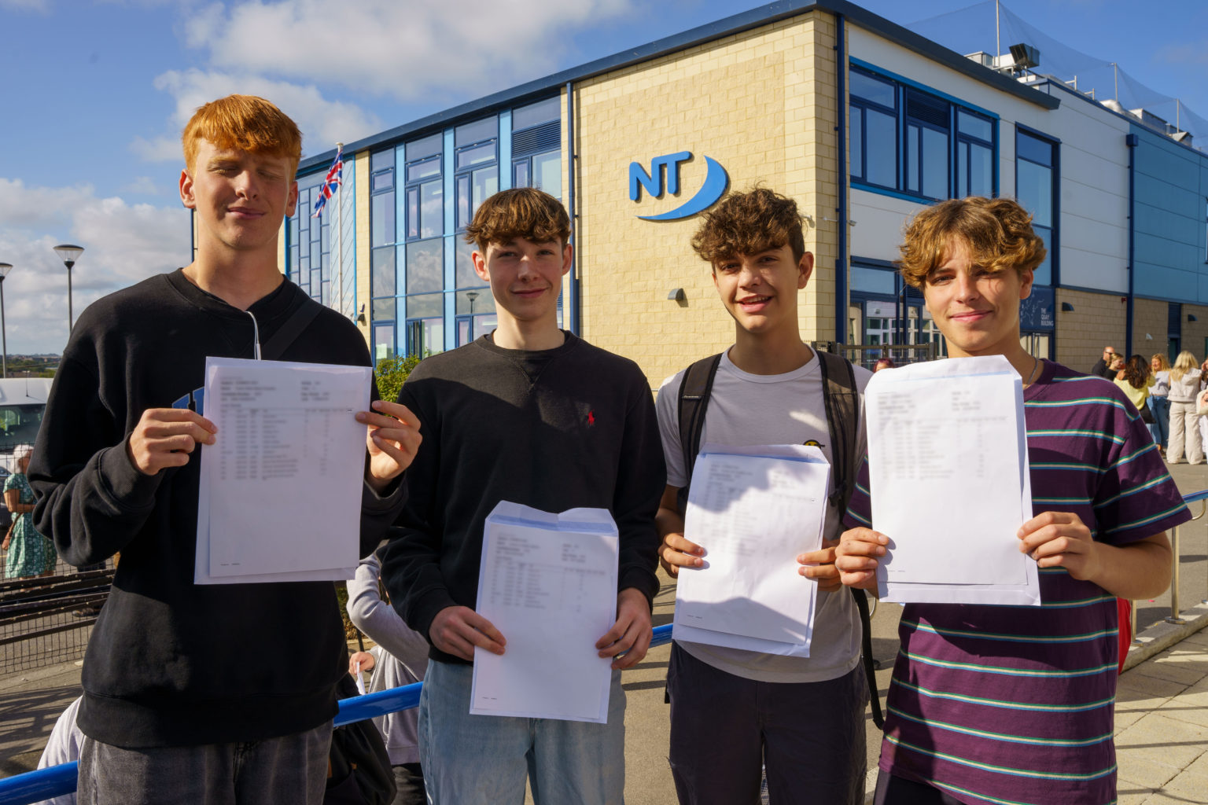
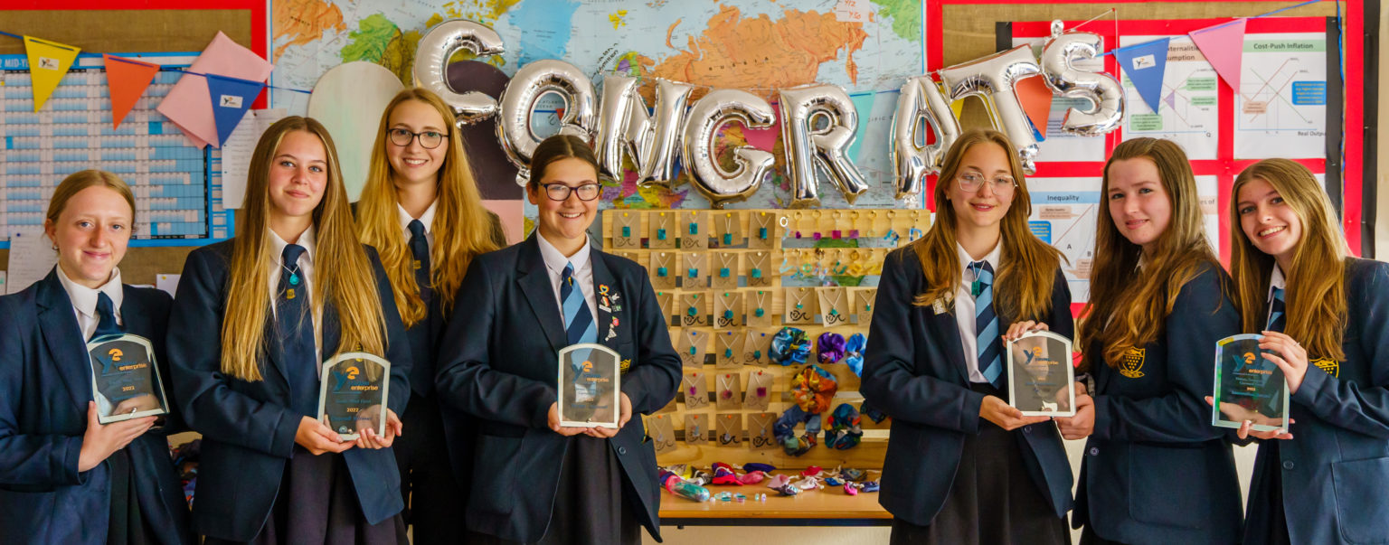
Educating the whole child: A curriculum for the 21st century
Achieve Highly
Communicate Convincingly
Engage Fully
Decide Wisely

Slide 6
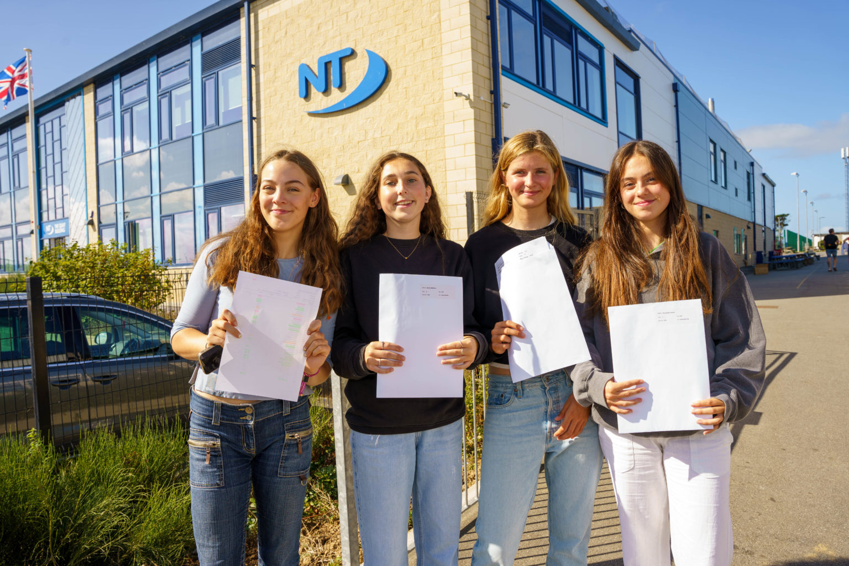
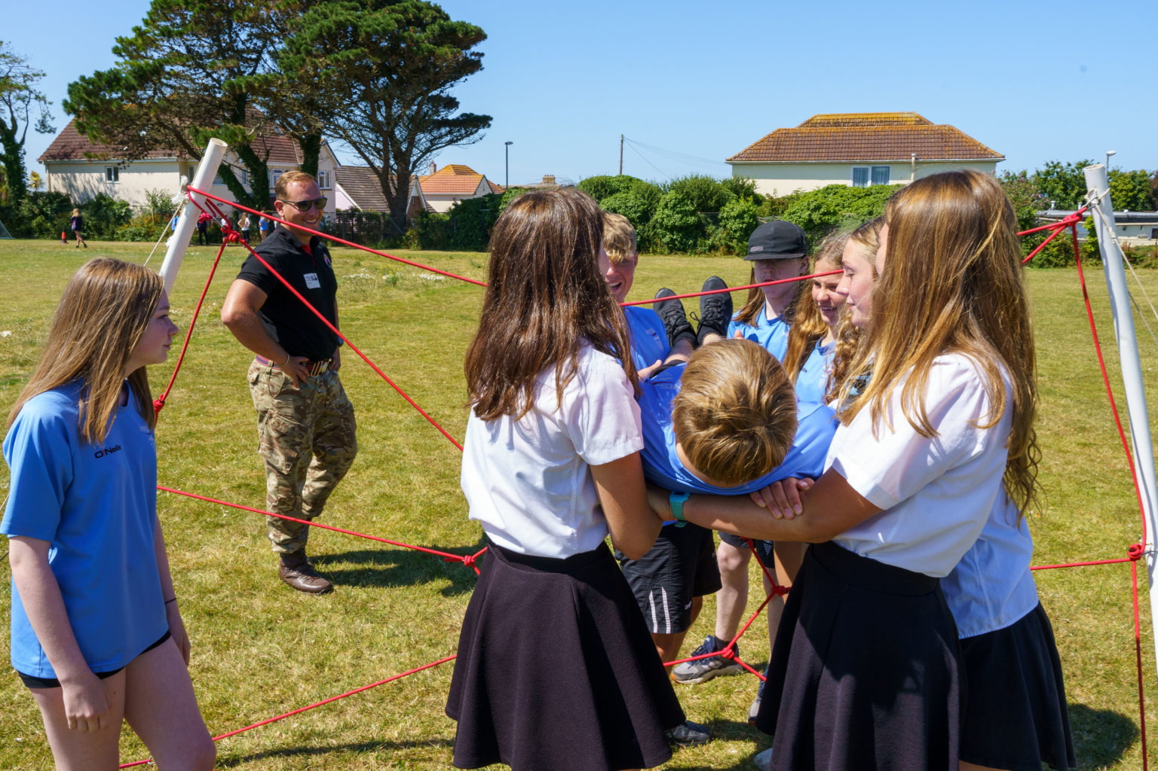
We believe in
Promoting every student’s progress in every lesson, every day
Being the best that we can be through nurturing talent and aiming high
Forging strong partnerships with parents & our local community

Slide 7
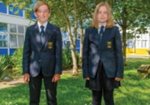
- Outstanding Pastoral care How we support your child at Tretherras
A Form Tutor that stays with their tutor group
Lots of house activities, trips and visits.
An extensive extra curricular programme.
Wellbeing Hub
A dedicated SEN Department offering personalised support and timetables for students with SEN and EAL.

Slide 8
- Outstanding Pastoral care A Smooth Transition
March - Transition paperwork
May – Primary School Visits
July – Transfer Day
September – Induction Day
Plus:
A PP Summer School
Year 11 Buddies and Year 10 mentors linked to every Form Group.

Slide 9
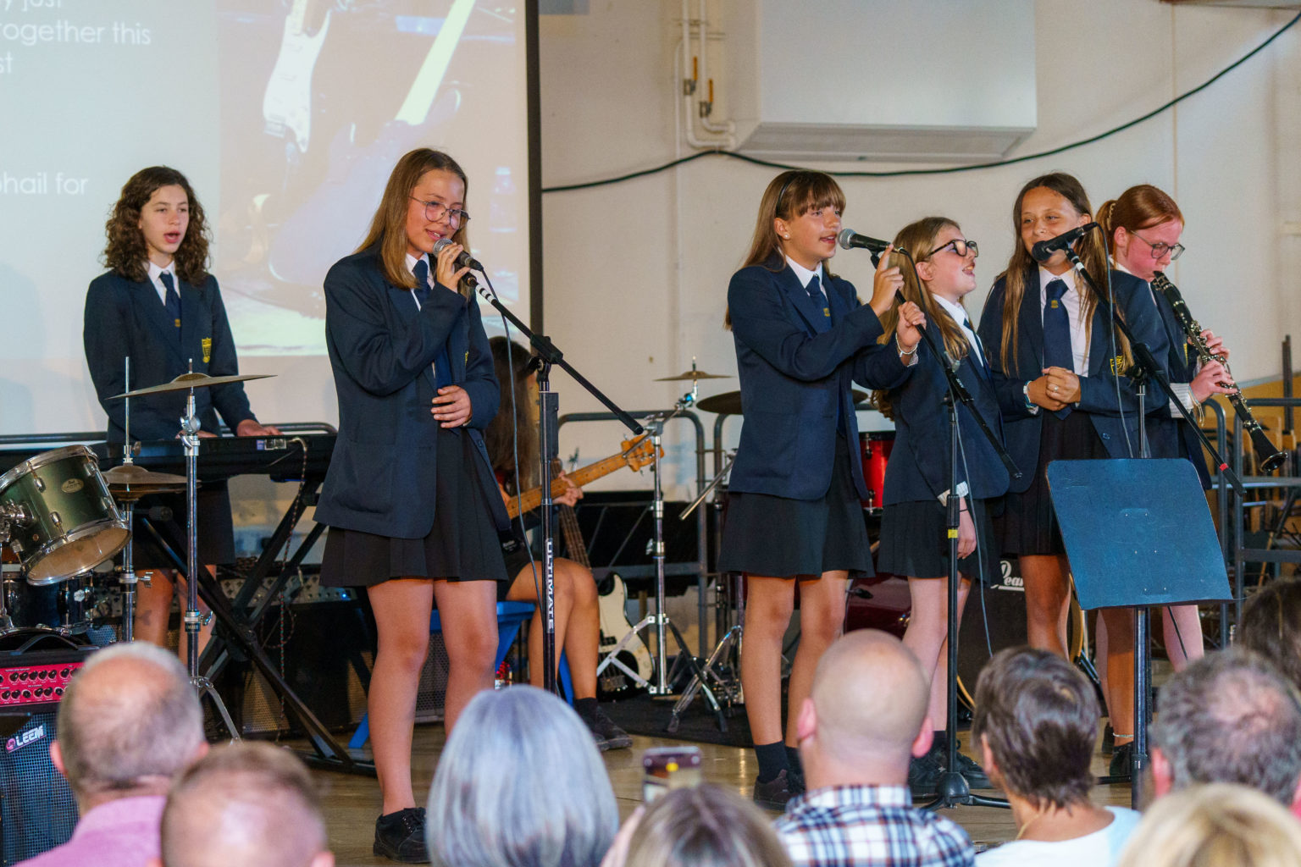
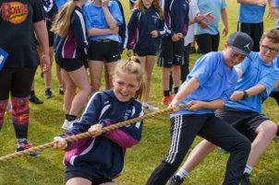
Extensive Extra Curricular offer
NT SPORT- OUR SPECIALISM
specialist coaches
local & national fixtures - inclusive & elite
partnerships with primaries
Sports Centre
CREATIVE ARTS
Dance shows
Productions
Community shows
Concerts
NT OUTDOOR LEARNING
DoE License
Adventure
Education Outdoors

Slide 10
Open Events
Open Evening
Open Morning – Friday 23rd September
9.15-10.45 (last tour at 10am)
Youth University
Science and PE
Maths and D.T
English and Art
Please see the booking link/
code on your booklet

Slide 11
How to Apply https://www.cornwall.gov.uk/schools-and-education/

Slide 12
How to Apply https://www.cornwall.gov.uk/schools-and-education/

Slide 13
How to Apply https://www.cornwall.gov.uk/schools-and-education/

Slide 14
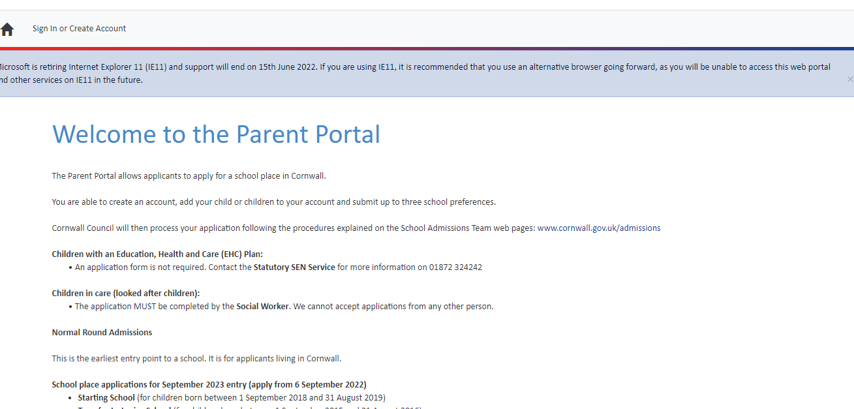
How to Apply https://www.cornwall.gov.uk/schools-and-education/

Slide 15
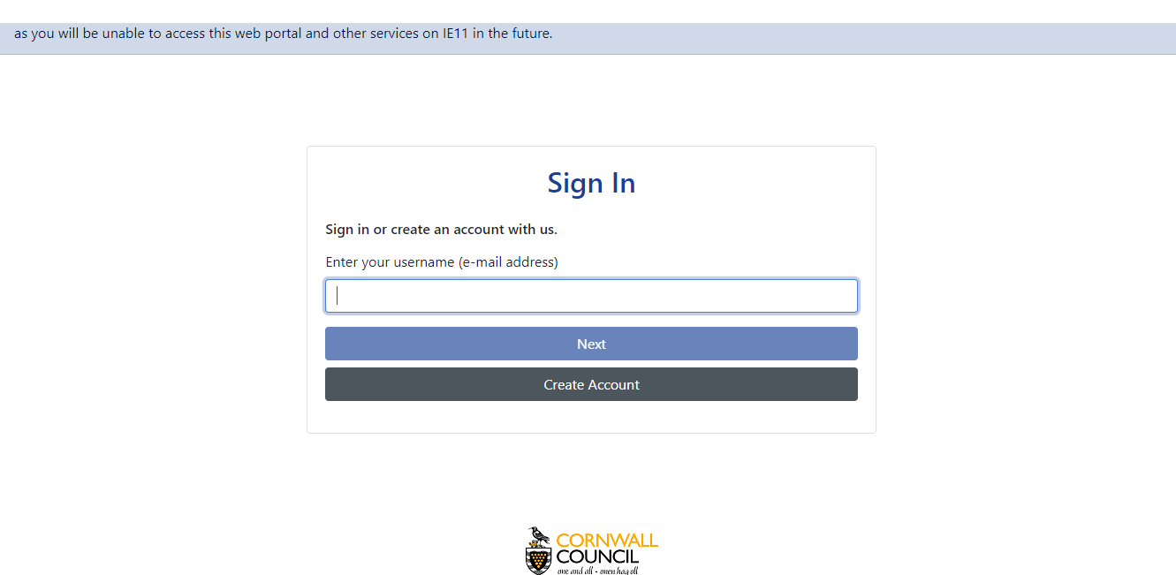
How to Apply https://www.cornwall.gov.uk/schools-and-education/

Slide 16
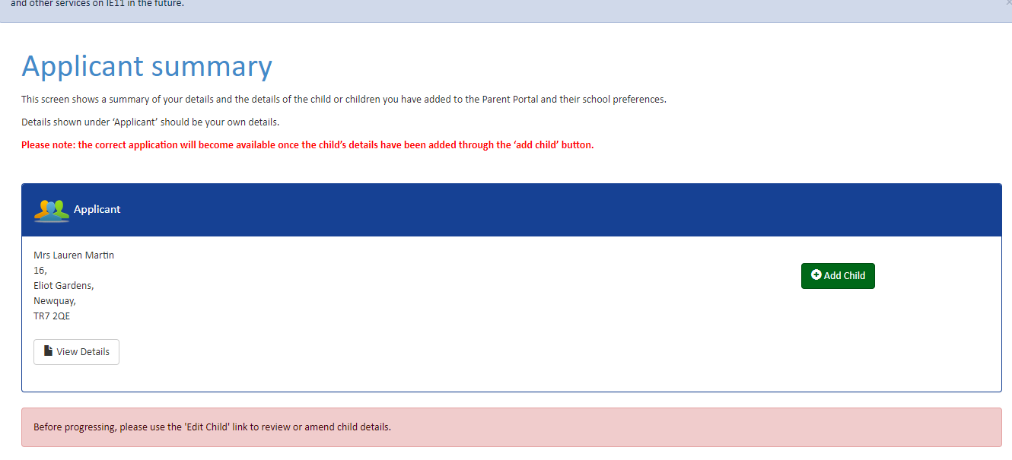
How to Apply https://www.cornwall.gov.uk/schools-and-education/

Slide 17
Back of leaflet

