Slide 1
Welcome to Tretherras

Slide 2
Key Dates:
February 8th
Y9 Options
Evening
February 22nd
Deadline
for Options
Forms
Year 10 & 11 – 2024-26

Slide 3
Compulsory Subjects

Slide 4
Compulsory Exam Subjects:

Slide 5
Compulsory other Subjects non-examined
Physical Education
Personal Social Health Education
Religion, Ethics and Philosophy

Slide 6
Optional Subjects

Slide 7
What are Ebacc subjects?
EBacc subjects, also referred to as ‘traditional’ or ‘facilitating’ subjects, are rigorous academic subjects, and good grades in these demonstrates to universities and employers how hard a student can work, whilst also teaching skills that are useful in a
wide range of higher education courses and careers.
Top universities and employers may look for candidates that have studied a modern foreign language (French or Spanish), and a humanity (History or Geography).
Whilst it is not essential to choose the full suite of EBacc subjects, we are strongly encouraging all of you to consider this in line with the government's intention that 90% of all students study the EBacc pathway.

Slide 8
Two Pathways
Blue Pathway
Yellow Pathway
Core Subjects – English, Maths and Combined Science
Your current MFL is a compulsory subject.
You must choose either History or Geography.
Choose 3 other subjects of which you will follow 2 on a best fit model.
Option to study Triple Science as 1 of your Options.
Core Subjects – English, Maths and Combined Science
You must choose 1 Ebacc subject from: History, Geography, MFL, Computer Science or Triple Science.
Choose 4 other subjects of which you will follow 3 on a best fit model.
Option to study other subjects from the Ebacc box in addition to the 1 you have already chosen.

Slide 9
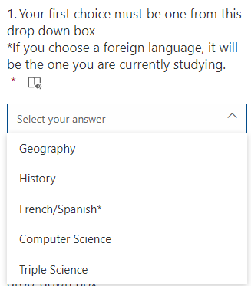
First, choose your Ebacc subject(s)
Blue Pathway
Yellow Pathway
MFL you are currently studying will be automatically selected for you.
Choose between studying either History or Geography.
If you want to study both you can choose the other humanity subject at the next step.

Slide 10
Within the Open Block there are a mix of GCSEs and Vocational subjects.
Subject
Geography
History
French/Spanish¹
Computer Science
Triple Science
Creative iMedia
Drama
DT Product Design
Engineering
Enterprise & Marketing
Health & Social Care
Hospitality & Catering
Media Studies
Music
PE/Sports Science²
Photography
Religious Studies
Sociology
Art³
3D Art³
GCSE subjects are typically assessed mainly through end of course written exams.
Vocational subjects have a higher degree of continuous assessment but still have external written exams.
We encourage all students to opt for a mix of GCSE and Vocational subjects.

Slide 11
Geography
History
Computer Science
Triple Science
Creative iMedia
Drama
DT Product Design
Engineering
Enterprise & Marketing
Health & Social Care
Hospitality & Catering
Media Studies
Music
PE/Sports Science²
Photography
Religious Studies
Sociology
Art³
3D Art³
Blue Pathway
Choose 3 subjects from the Open Block.
This can include the humanity subject (geography/history) that you haven't already selected

Slide 12
Geography
History
French/Spanish¹
Computer Science
Triple Science
Creative iMedia
Drama
DT Product Design
Engineering
Enterprise & Marketing
Health & Social Care
Hospitality & Catering
Media Studies
Music
PE/Sports Science²
Photography
Religious Studies
Sociology
Art³
3D Art³
Yellow Pathway
Choose 4 subjects from the Open Block.
This can include any EBacc subject not already selected previously.

Slide 13
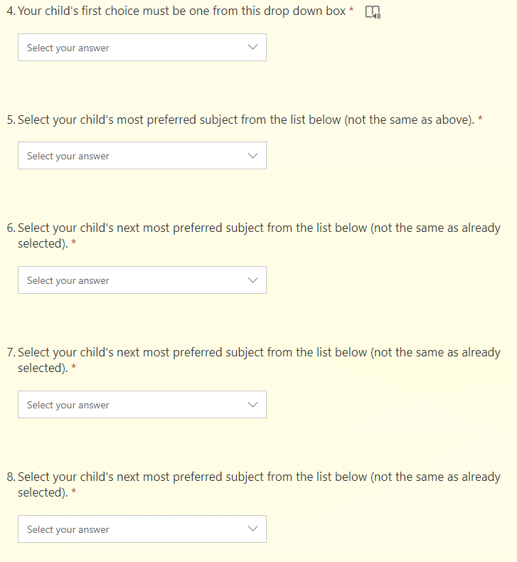
On the form, select a different subject in each question, in preference order.
Your option form will be emailed to your parents. Check they have received it, check junk/spam folders.
*If you choose a foreign language, it will be the one your child is currently studying.
**If you choose PE/Sport Science we will choose the most appropriate course for your child (GCSE or vocational).​ ***If you choose Art/3D Art please indicate which of those 3 options your child would most prefer, at the end of the form.

Slide 14
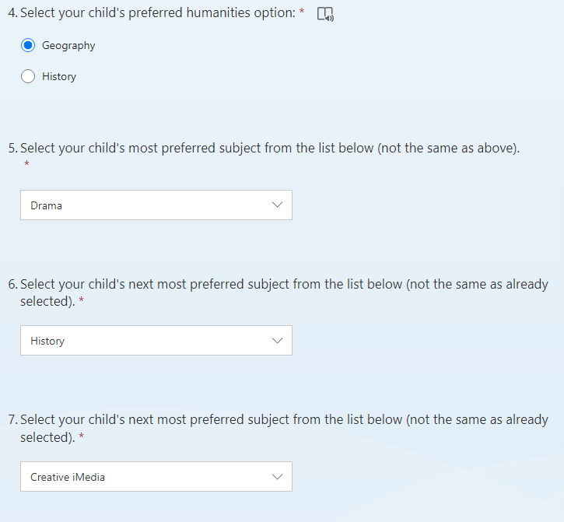
Blue Pathway Example Form
This student has chosen Geography over History and is studying their MFL
They have then chosen their other 3 options from the open section in order of preference:
Drama, History and Creative iMedia

Slide 15
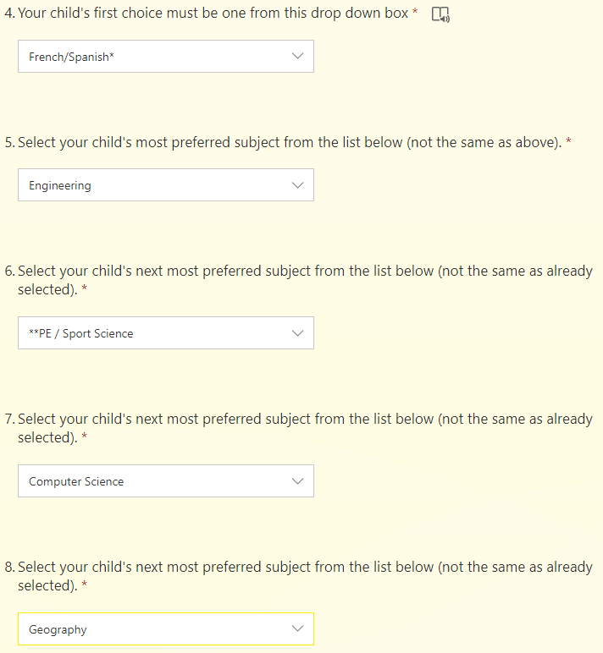
Yellow Pathway Example Form
This student has selected French/Spanish, which for this student means Spanish
They have then chosen their other 4 options from the open section in order of preference:
Engineering, PE/Sport Science, Computer Science and Geography

Slide 16
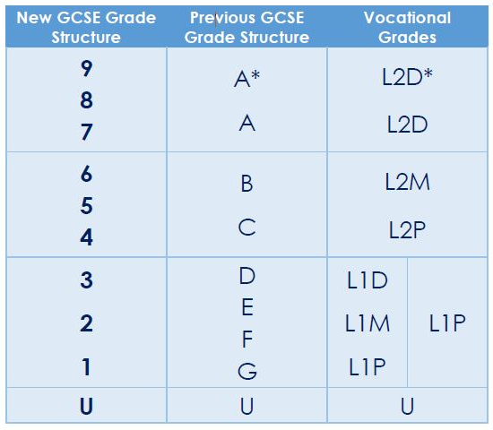
All GCSEs are now graded on a 9 to 1 scale.
Vocational subjects have a different grade structure (as shown).

Slide 17
Should I base options on what I’m good at?
Should I base options on what I enjoy?
Should I choose a subject because I like the teacher?
Should I choose a subject because my friends are doing it?
Should money & future salary be a factor when I’m choosing my options?
Whose advice should I listen to when choosing my options?
Are my A-level choices affected by the subject choices I make now?
Do universities care about which options you choose?
Should I think about how courses are marked when choosing my options?
How important is it to get good grades in my GCSEs?
Should I take subjects which aren’t GCSEs?
Does my final GCSE options list look balanced?

