Slide 1
Class of 2027
Preparing for Key Stage 4

Slide 2
Year 9 Options Evening
Wednesday, 12th February
Option website launch
Monday, 10th February
Careers Fayre
30th January
Option Form
Thursday, 27th February
KS4 Taster Lessons
27th January – 7th February
Options Deadline
Friday, 21st March
Options Confirmed
WB 28th April
Year 9 Progress Report
WB 20th January

Slide 3
Compulsory Subjects
Examined
GCSE English Language
GCSE English Literature
GCSE Mathematics
GCSE Science
Non-examined
Physical education
Personal, social, health and economic education
Religious education
Notes:
Peake is working!

Slide 4
Option Subjects
Our ambition for students is simple.
We want our students to become confident and resilient young adults who: Achieve Highly, Communicate Convincingly, Engage Fully and Decide Wisely.
A key priority for our Key Stage 4 curriculum is to provide all learners with access to an ambitious and engaging curriculum that motivates them to achieve their best.

Slide 5
Option Subjects
A good balance of subjects so that students avoid narrowing future choices
The subjects students show an interest in and enjoy the most. Students will often be more successful at what they enjoy!

Slide 6
Option Subjects
The subjects that give students a breadth of learning across the curriculum and are seen to give students the best opportunities for future study are:
English (compulsory)
Mathematics (compulsory)
Science (compulsory)
a Modern Foreign Language (French or Spanish)
a traditional option (Computer Science, Geography, History or Separate Sciences)

Slide 7
Option Subjects
Some students will be recommended to study a language.
All students will be recommended to chose at least two traditional subjects:
Computer Science
French
Geography
History
Separate Sciences
Spanish
All students will only be able to take 1 OCR vocational qualification
*Additional pathway for a select group of students who we deem will benefit from a specific combination of options

Slide 8
Why is studying a language important?
The benefits of learning languages are undeniable. People who speak more than one language have improved memory, problem-solving and critical-thinking skills, enhanced concentration, ability to multitask, and better listening skills.
It helps students to become confident communicators, able to speak publicly and promote themselves effectively- important life skills.
It helps with understanding other cultures and develops tolerance and understanding.
All in all, it not only helps to improve students’ performance in all subject areas, it provides many varied future education and employment opportunities, alongside developing rounded individuals.

Slide 9
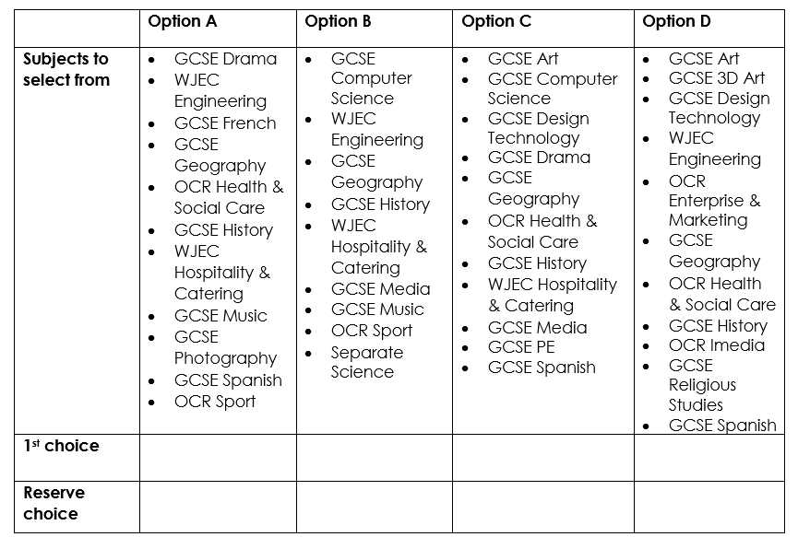
Applying for your options
Select a first choice and a reserve choice from each of the option blocks.
Only select one subject once.
We will do our best to ensure as many students as possible can study all their first-choice subjects.

Slide 10
What do you need to do?
Be open minded

Slide 11
What do you need to do?
Be reflective

Slide 12
What do you need to do?
Be inquisitive

Slide 13
What do you need to do?
Think long term…
keep every door open to you

Slide 14
What do you need to do?
Talk through your thoughts with others

